Slide 12
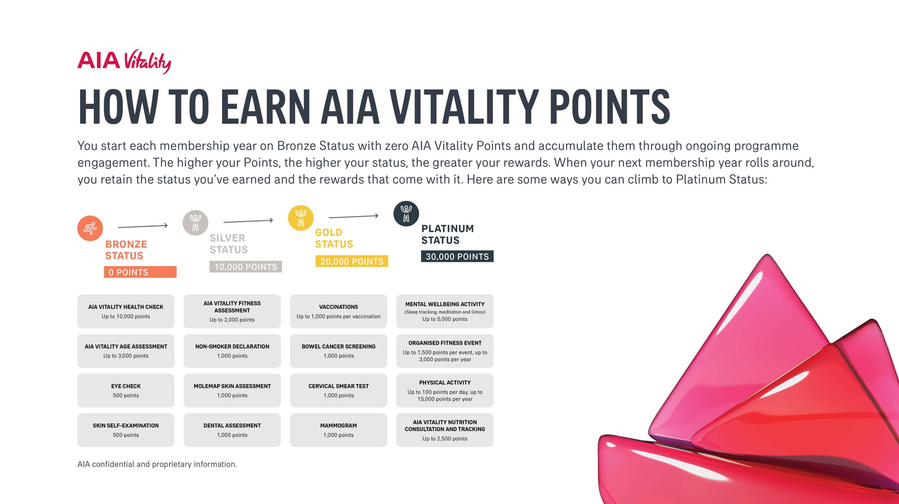

Slide 28
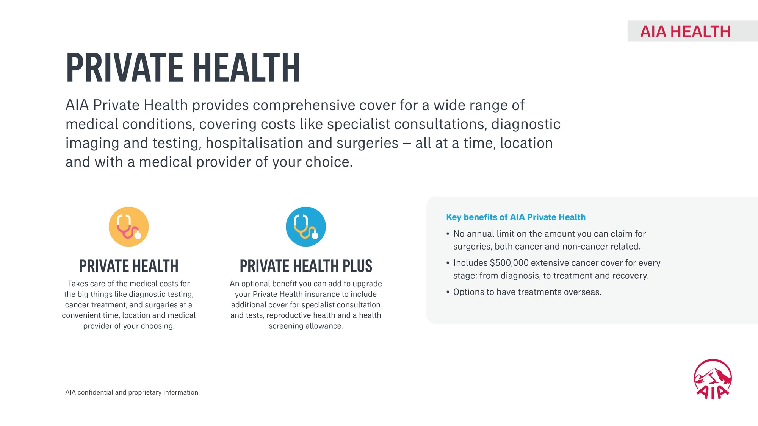

Slide 30
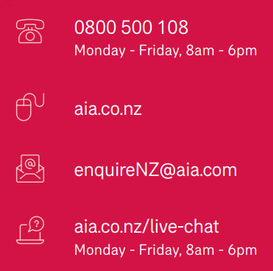
Adviser Full Name
M: <<Mobile>
P: <<Phone>>
E: <<Email>>
Disclaimer
Other things you should know: the availability of insurance cover is subject to your application being approved. All applications are subject to individual consideration. Special conditions, exclusions and premium loadings may apply. This insurance is underwritten by AIA New Zealand Limited (‘AIA’). For full details of the products and benefits offered by AIA, please refer to the policy document(s) which are available from AIA. The information contained in this publication is general in nature and is not intended as advice. It may not be relevant to individual circumstances and before making any insurance decision, you should consult a professional Adviser. Copies of our disclosure statements are available on request, free of charge.
Copyright © February 2023, AIA New Zealand Limited (352806). All rights reserved. The information contained in this document is current at the time of publication and is subject to change at any time.

